Slide 1
Front-running the fed
Using NLP to predict FX volatility from FOMC Statements
Ben Rounds

Slide 2
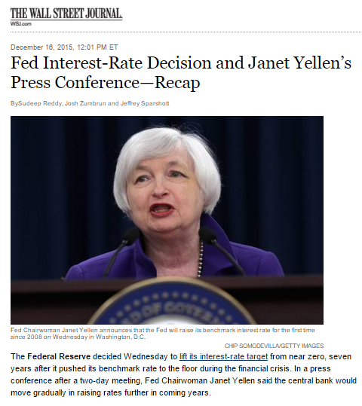
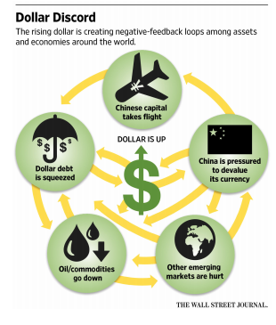
The question
“Buy the rumor, sell the news”
Can natural language processing on Fed policy statements reveal insights
Process
Seek to distill individual statements (8/year) into sentiment indicators
Assess returns to US dollar versus other currencies

Slide 3
The data
Two data sets – both public:
Federal Open Market Committee (FOMC) press releases
USD currency pairs for non-pegged currencies
Cleaning?
Intend to use spacy to clean text data
Currency exchange rates clean with the exception of a single data point

Slide 4
The Data exploration
Completed
Preliminary exploration and cleaning for outliers and dirty data
Currency moves appear to follow meaningful trends
Further Exploration
While analysis hopes to use FOMC statements to assess sentiment and tests converse reaction, analysis could be expanded by incorporating Twitter data

Slide 5
The Model
Plans
Clean and vectorize text data using spacy
Utilize public financial NLP library to assess sentiment of individual statements
Assess volatility and returns of currencies against the dollar following announcement
Potential Expansion/Questions:
Use Twitter data to test sentiment leading up to announcement data
Suggestions…

